Slide 1

Data Visualization in Python
Diabetes Predictive
Rakshith M 1BY21CS146
Sai Sathvika 1BY21CS159
Shaik Sania 1BY21CS169
Syed Adil 1BY21CS197

Slide 2

Diabetes Predictive System
This presentation outlines the development of a machine learning model to predict diabetes. We'll explore the dataset, perform data analysis and visualization, build a Support Vector Machine classifier, and create a predictive system to determine if a patient is diabetic based on input features.

Slide 3

Importing Libraries and Data
We begin by importing necessary Python libraries for data analysis, visualization, and machine learning. These include NumPy, Pandas, Seaborn, Matplotlib, and Scikit-learn components. The diabetes dataset is loaded from a CSV file, containing 768 entries with 9 columns including features like pregnancies, glucose levels, blood pressure, and the target variable 'Outcome'.
1
Import Libraries
NumPy, Pandas, Seaborn, Matplotlib, Scikit-learn
2
Load Data
Read CSV file into Pandas DataFrame
3
Initial Exploration
View first few rows of the dataset

Slide 4
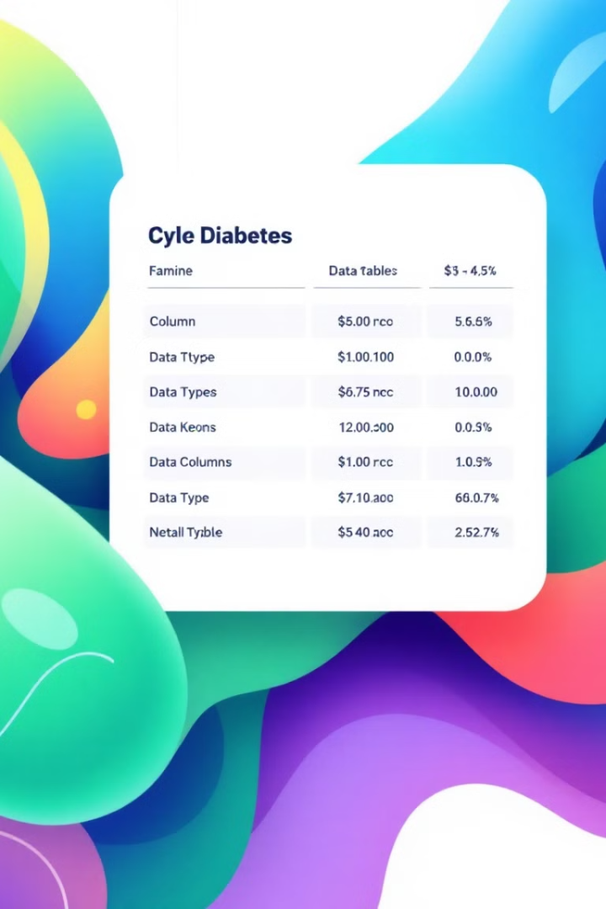
Dataset Overview
The dataset consists of 768 rows and 9 columns. We use df.info() to get an overview of the data types and non-null counts. All columns are numeric, with 7 integer columns and 2 float columns. The features include Pregnancies, Glucose, BloodPressure, SkinThickness, Insulin, BMI, DiabetesPedigreeFunction, Age, and the target variable Outcome.
Rows
Columns
768
9
Data Types
Non-null
7 int64, 2 float64
All columns fully populated

Slide 5
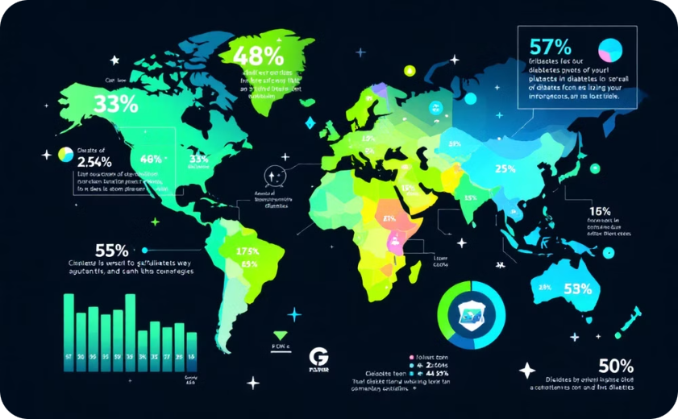
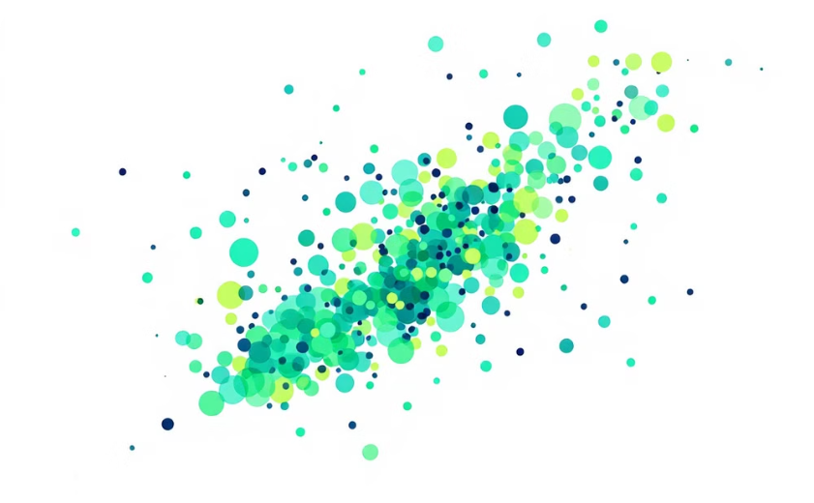
Data Description and Visualization
We use df.describe() to get statistical summaries of the dataset. This provides insights into the distribution of each feature, including count, mean, standard deviation, minimum, maximum, and quartile values. To visualize relationships between features, we create a pairplot using Seaborn, which shows scatterplots for each pair of features, color-coded by the Outcome variable.
Statistical Summary
Feature Pairplot
Descriptive statistics for each feature
Visualizes relationships between features

Slide 6
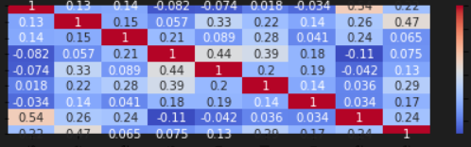
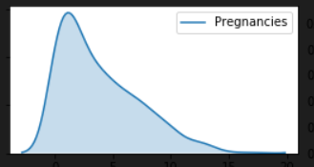
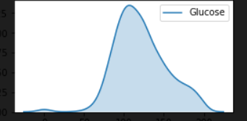
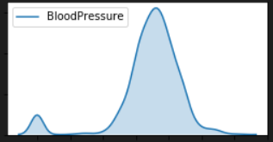
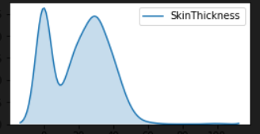
Data Description and Visualization
To visualize the distributions of numerical columns in a DataFrame along with their correlations and also the subplots of each attributes.
Heat Map
Creates a grid of subplots with 2 rows and 4 columns.

Slide 7
Correlation Analysis
We generate a correlation heatmap to visualize the relationships between different features. This heatmap uses color intensity to represent the strength of correlations, with darker colors indicating stronger correlations. We also create individual distribution plots for each feature using Seaborn's kdeplot function, which helps visualize the probability density of each variable.
Correlation Heatmap
Distribution Plots
Insights
Visualizes feature correlations using color intensity
Shows probability density for each feature
Helps identify potential predictive features and relationships

Slide 8

Target Variable Analysis
We analyze the target variable 'Outcome' by grouping the data and calculating mean values for each feature based on the outcome. This helps identify differences in feature values between diabetic and non-diabetic patients. We also examine the distribution of the target variable, revealing an imbalanced dataset with 500 non-diabetic (0) and 268 diabetic (1) cases.
Outcome
Count
0 (Non-diabetic)
500
1 (Diabetic)
268

Slide 9
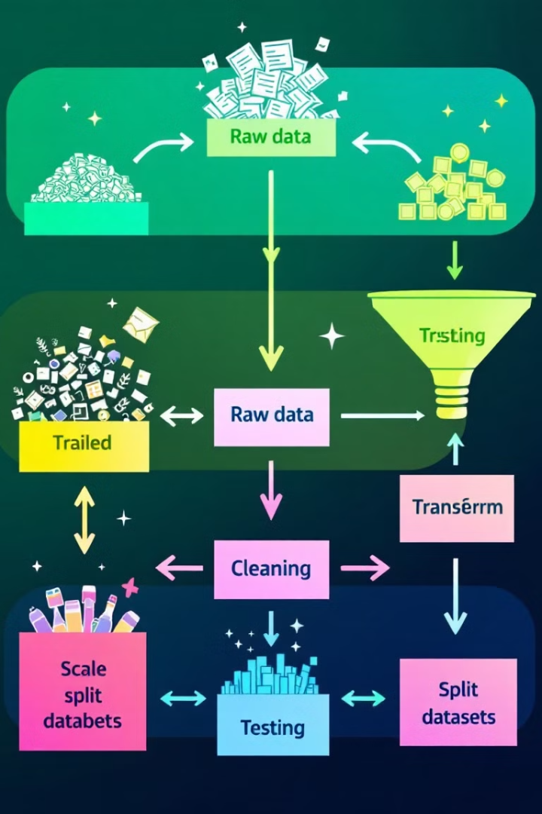



Data Preprocessing
We prepare the data for model training by splitting it into features (X) and target (y). The features are then scaled using StandardScaler to normalize the data. This scaling is crucial for many machine learning algorithms, including Support Vector Machines, to perform optimally. We then further split the data into training and testing sets, using a 80-20 split and stratifying based on the target variable to maintain class balance.
Split Features and Target
Separate X and y
Scale Features
Normalize using StandardScaler
Train-Test Split
80% training, 20% testing

Slide 10

Model Training and Evaluation
We train a Support Vector Machine (SVM) classifier with a linear kernel and C=10.0. The model is fit on the training data and used to make predictions on the test set. We evaluate the model using several metrics: accuracy score, confusion matrix, and classification report. The model achieves an accuracy of 80.52% on the test set, with slightly lower training accuracy (76.87%), indicating good generalization without overfitting.
1
Model
2
Accuracy
Support Vector Machine (linear kernel, C=10.0)
Test: 80.52%, Train: 76.87%
3
Confusion Matrix
4
Evaluation Metrics
[[89 11], [19 35]]
Accuracy, confusion matrix, classification report,F1 score

Slide 11





Predictive System Deployment
Finally, we create a prediction function that takes input data for a single patient and predicts whether they are diabetic. This function preprocesses the input data, applies the trained model, and returns the prediction. We test the function with two sample inputs, demonstrating its ability to classify patients as diabetic or non-diabetic based on their health metrics.
Input Data
Preprocessing
Model Prediction
Result
Patient health metrics
Scale and transform data
Apply trained SVM
Diabetic or Non-diabetic

Slide 12
THANK YOU

